Slide 1


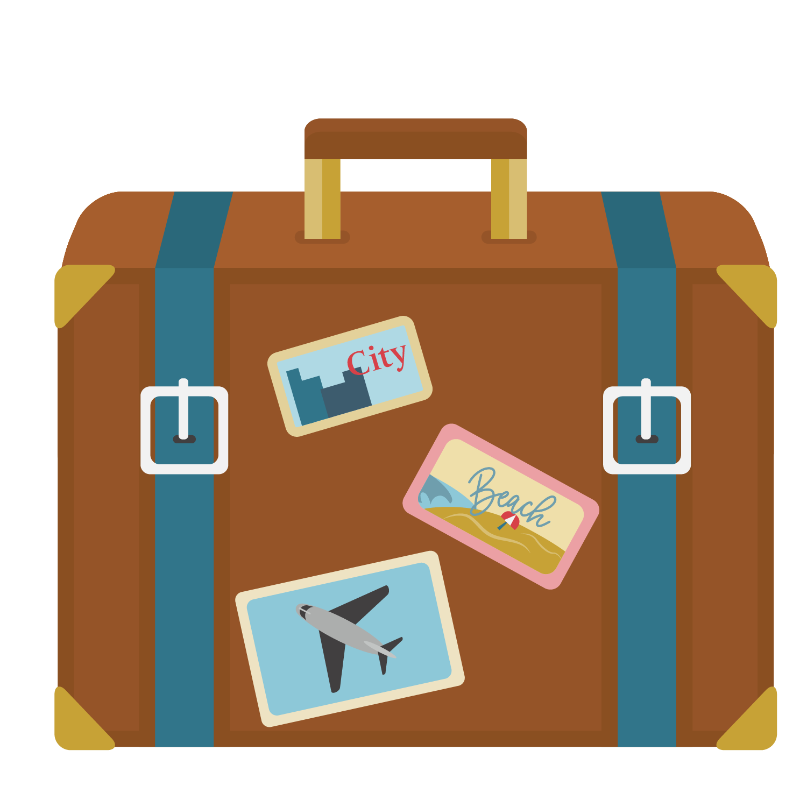
Stay Safe on
Spring Break

Slide 2
What are your plans for spring break this year?

Slide 3
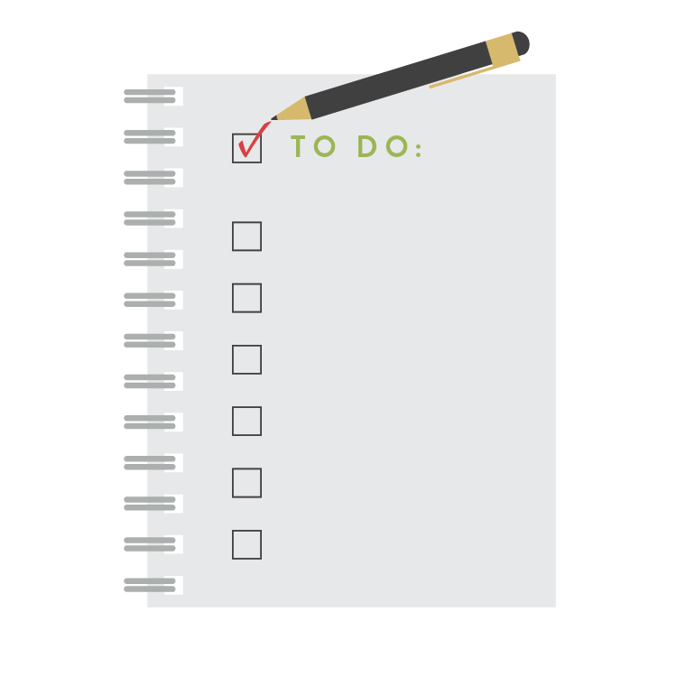
How can you plan for a safe spring break experience?
Research your destination.
Share your travel itinerary and contact information with someone who is not traveling with you in case of an emergency.
Pack sunscreen, sunglasses, protective clothing, lip balm with SPF and a water bottle if you will be outdoors.
Leave expensive or valuable belongings secure at home or in your campus residence.

Slide 4


If you are driving …
Have your vehicle checked or inspected.
Create a back-up plan if you have car troubles while on the road.
Map your route ahead of time.
Drive on heavily traveled interstates and freeways.
Budget time for stops and breaks.
Travel during daylight hours.
Rotate drivers if traveling long distances.
Lock your vehicle with your windows up when you are not driving.

Slide 5

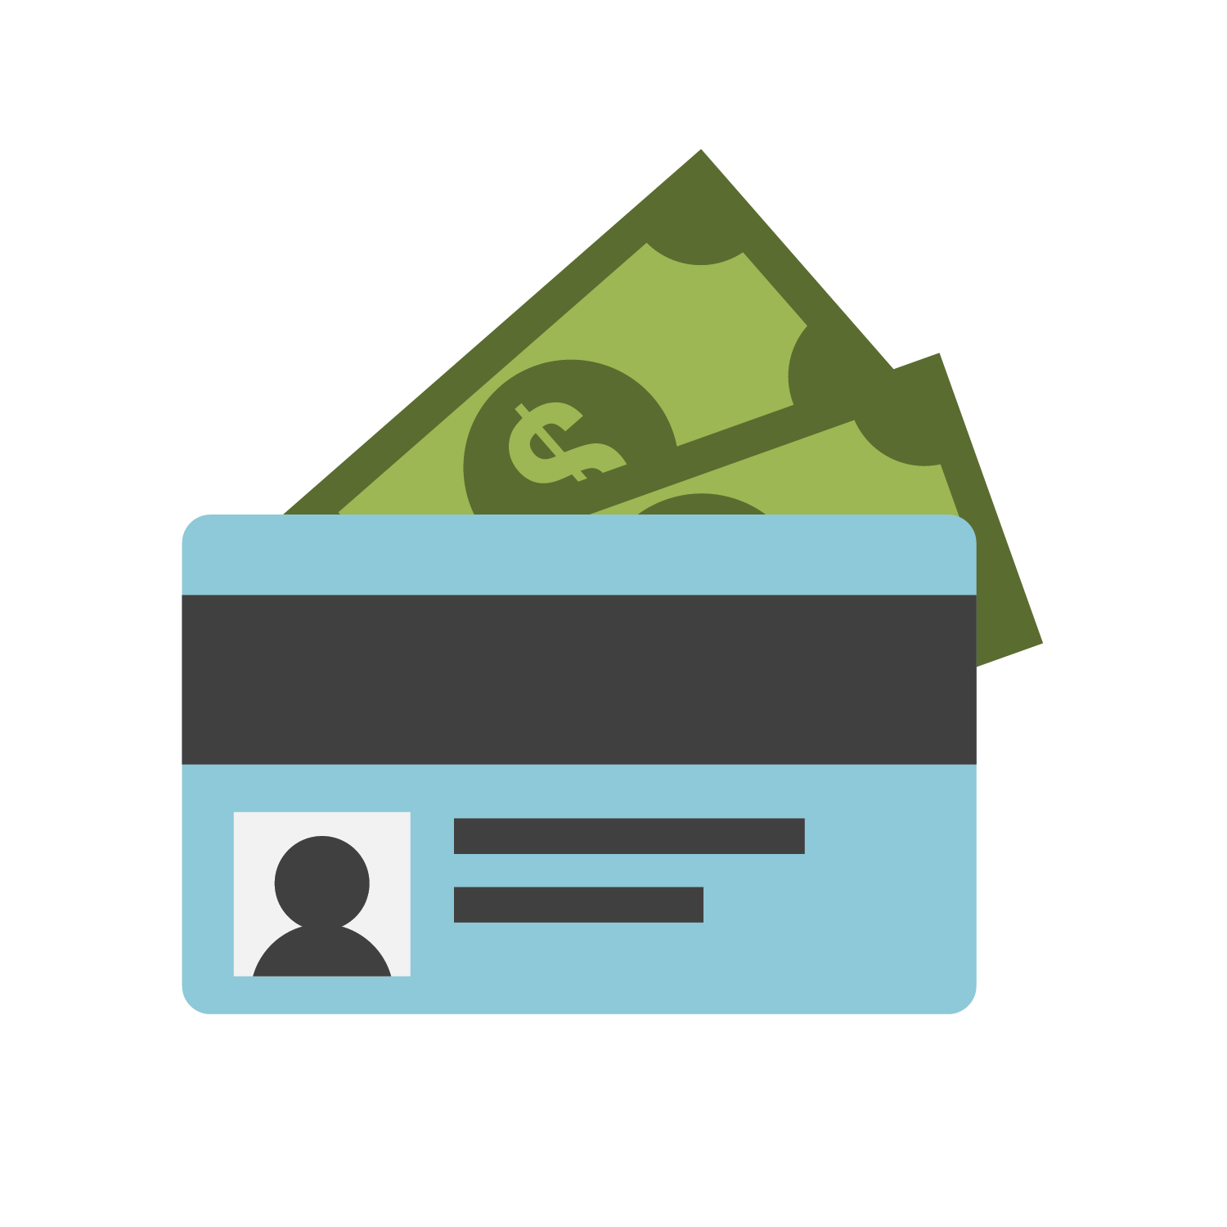
If you are flying or traveling aboard …
Take a copy of your identification and plane ticket.
Bring a small portion of funds with you in the local currency for emergency use.
Check for travel warnings before departure/arrival and when entering/exiting another country.
Verify your cell phone carrier service if traveling abroad.

Slide 6
What are ways to ensure your personal safety and well-being during spring break?
SHARE 1-2 TIPS WITH A SISTER.

Slide 7

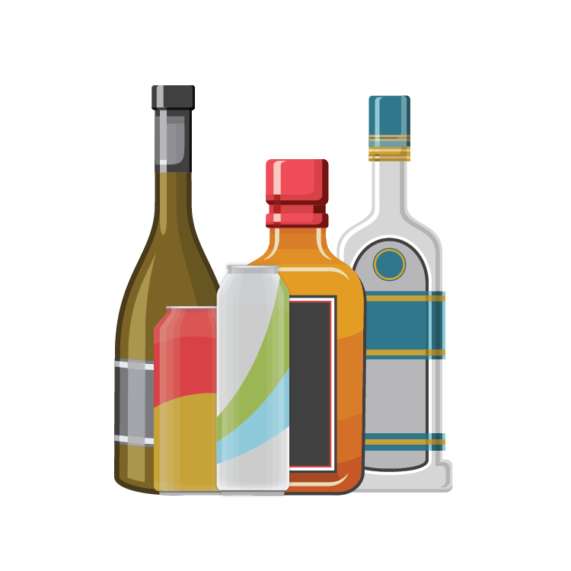
Safe Spring Break Tips
Follow all federal, state and local laws.
Practice safe drinking if you are of legal drinking age.
Keep your ID on hand and know where your driver’s license is at all times.
Be discrete when using your credit card or an ATM in public places.
Only use taxis, shuttle buses or ride-share services (Lyft or Uber) with people you know.

Slide 8


Safe Spring Break Tips
Travel in a group with those you trust.
Drink plenty of water to avoid dehydration.
Wear sunscreen and reapply every 2 hours.
Do not swim alone, in the dark or after consuming alcohol.
Contact emergency personnel if you need help or immediate assistance.

Slide 9
How else can you make your spring break a safe and memorable one?
BRAINSTORM IDEAS WITH A SISTER.

Slide 10



Spring Break Safety Tips
Check in with those back home regularly.
Avoid sharing personal information with individuals you do not know.
Protect your location on social media by not sharing in real time.
Be mindful of what you post online.
Understand the impact of your decisions.

Slide 11

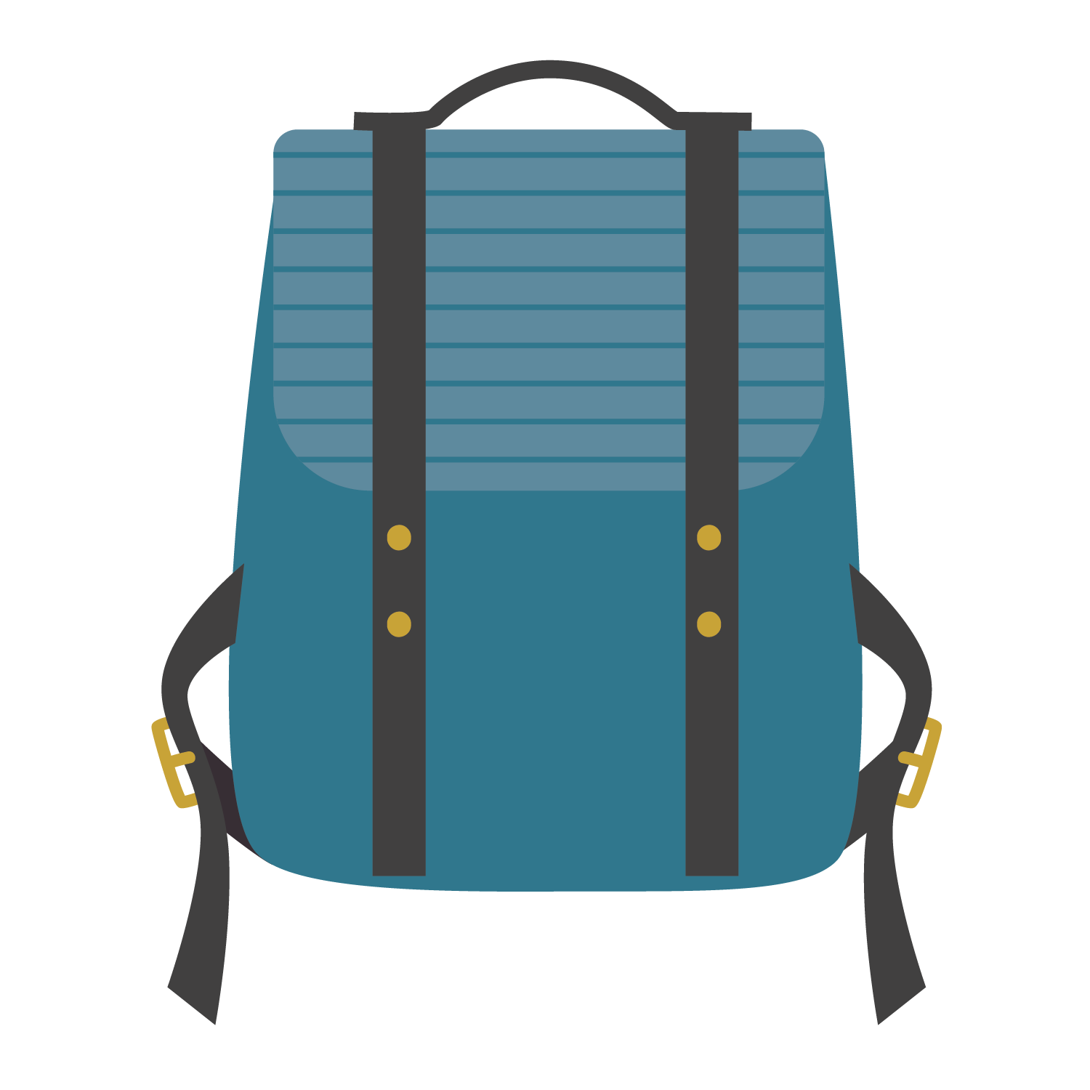
Be Aware.
Be Responsible.
Be Alert.

